Slide 1

Clements SNHS Voltrack Semester 1 Report
Anika Yamdagni
4th Period

Slide 2
Project Summary
Topic
Web Application Development
Purpose
Track information on volunteer sessions done by the members of Science National Honor Society (SNHS) at Clements HS

Slide 3
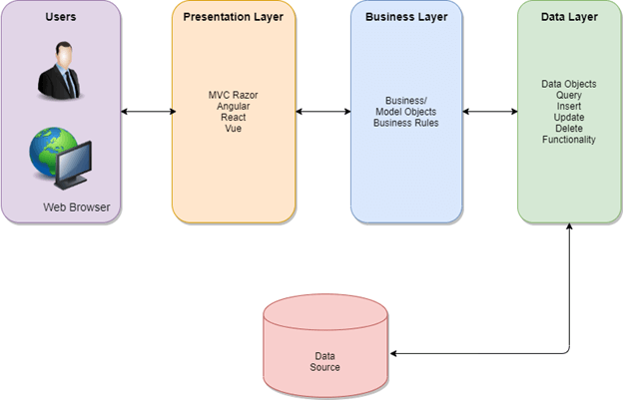
Where Am I in the 3 Tiers of Web Development?
First, I completed the presentation layer or front-end of my web application
Learned and used HMTL, CSS, Bootstrap, and Vue.JS
Constructed the full GUI and included all elements of user interaction
Next, I completed the data layer or back-end of my web application
Learned and used MSSQL along with its TSQL extension
Formulated how the user data would be stored
Now, I am focusing on the business layer by connecting the front-end to the back-end to complete the development of my web app!!

Slide 4
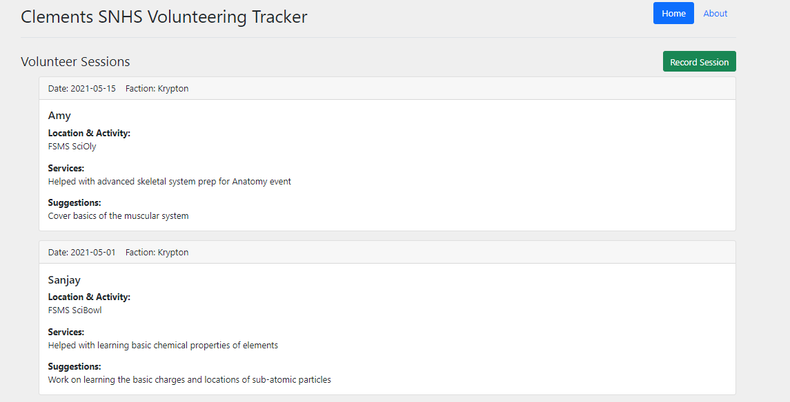
Front-End Application

Slide 5
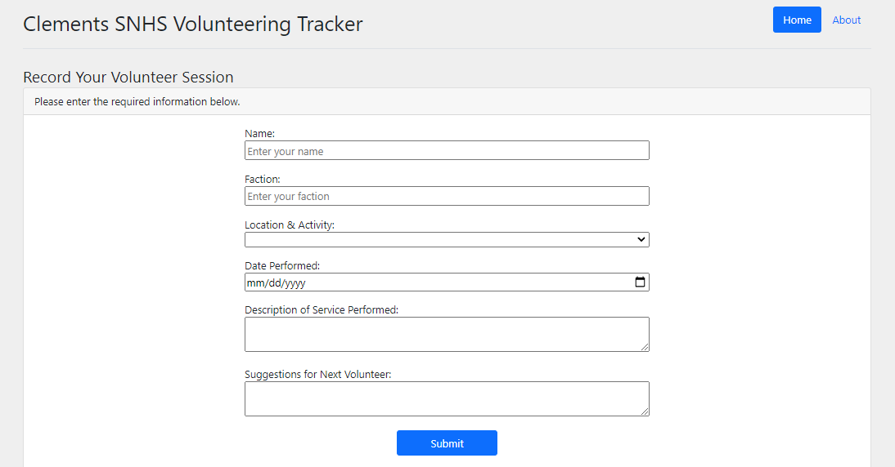

Slide 6
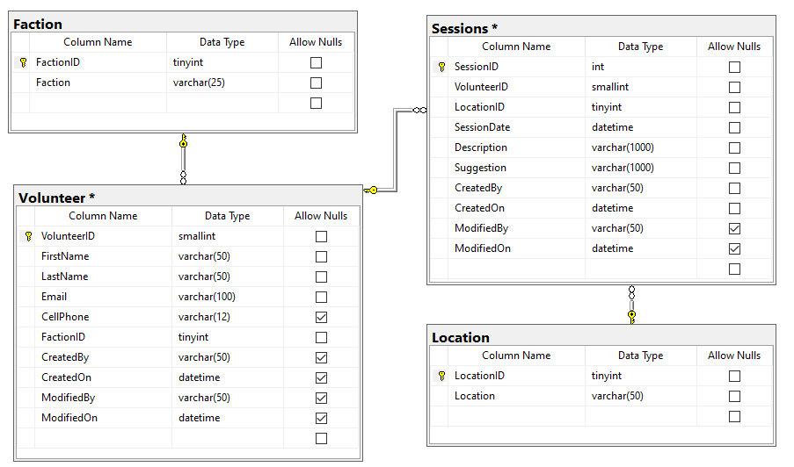
Voltrack Database

Slide 7
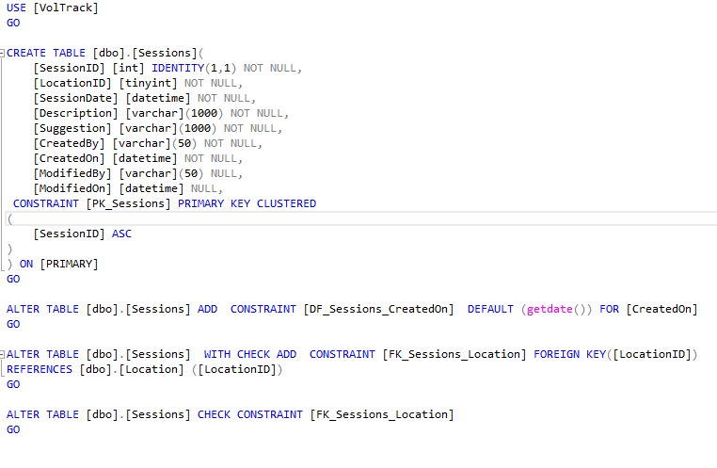
T-SQL Code to Create A Table

Slide 8
RESTful Web APIs
REST stands for Representational State Transfer, a software architectural style that was created to guide the design and development of the architecture for the World Wide Web
A RESTful API (also known as REST API) is an application programming interface (API or web API) that conforms to the constraints of REST architectural style and allows for interaction with RESTful web services.
They enable you to develop any kind of web application having all possible CRUD (create, retrieve, update, delete) operations.
REST guidelines suggest using a specific HTTP method on a particular type of call made to the server

Slide 9
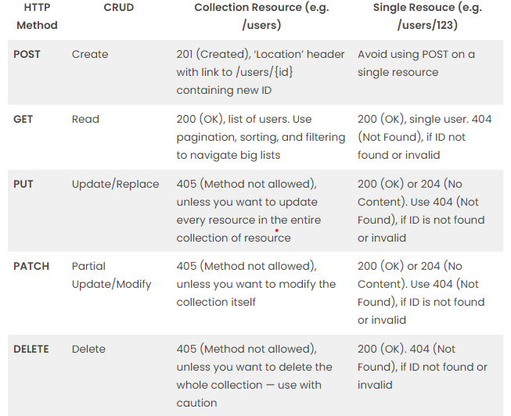
HTTP Requests

Slide 10
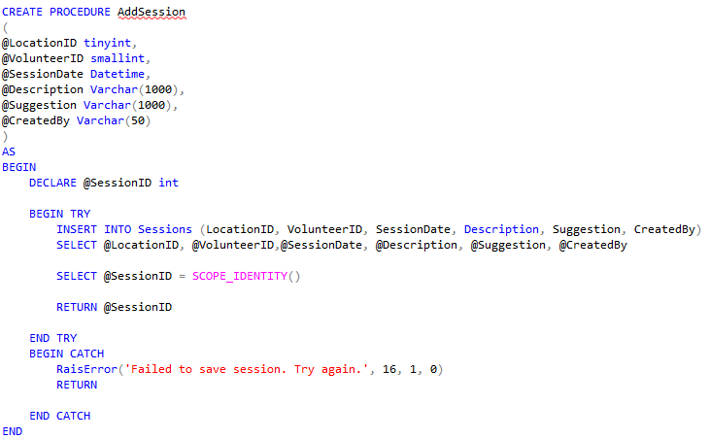
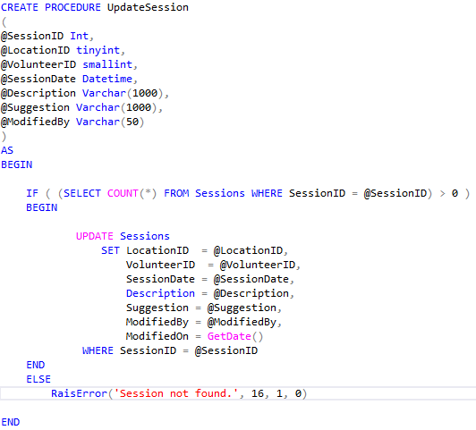
Store Procedures Called By API

Slide 11
API Development
I hope to use my knowledge of HTTP requests, especially those of GET and POST requests and apply it to the business layer of my web application:
Retrieve the data from my MSSQL tables to display in the front-end via RESTful GET APIs
Save the data entered by the user in the front-end via RESTful POST APIs
Since I am familiar with Java and it is an efficient way to execute the connection between my data storage and display, I planned to use Java to write my web APIs
I began investigating which Java frameworks were available and I found two sufficient options: Jersey and Spring Boot
After researching them both, I discovered that I would have to use a paid, professional hosting software because I could not find any that offered free combinations of Java frameworks with MSSQL ☹
I finalized using ASP.NET because it is made by Microsoft (just like MSSQL), and it contains all the necessary components I require

Slide 12
ASP.NET with c#
Since I switched to ASP.NET which uses C#, it was a steep learning curve for me as there are many key comparisons between Java and C#:
Similarities
Differences
Object-Oriented
Dependence from C and C++
Intermediate Language Code Generation
Advance Features (i.e., garbage collection)
Syntax
Multiple Inheritance
Runtime Environment
Programming Paradigm
Operator Overloading
Pointers
Arrays

Slide 13
Current Steps:
Writing the code to develop my web APIs in
ASP.NET!
Researching how to add login functionality!
Need login feature to enable users to update/delete their previously recorded sessions
Learning Microsoft ASP.NET Identity using OWIN (Open Web Interface in .NET)

Slide 14
Next Steps:
Conduct Unit Testing!
Will test each independent feature of my web app piece-by-piece to ensure that everything is functioning independently
Conduct System Testing!
Will test the full working capabilities of my web application as a whole
Finalize Hosting Platform & URL!

Slide 15
Sources
https://restfulapi.net/http-methods/
https://www.redhat.com/en/topics/api/what-is-a-rest-api
https://journaldev.com/9170/restful-web-services-tutorial-java
https://www.guru99.com/java-vs-c-sharp-key-difference.html

